Slide 1
Workshop Kick-Off & ITS Updates Garret T. Yoshimi VP of Information Technology & CIO

Slide 2
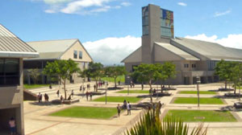
Annual IT All-Campus Workshop 2016 Edition
Good Morning!
Logistics, Schedule, Announcements
Thank You to Our Gracious Host: UH West Oʻahu

Slide 3
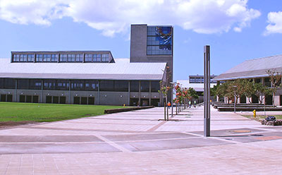
FY16 Highlights
Banner STAR Registration UI
MyUH Services
New Palamanui Campus
Executive Branch DR Site @ ITC
Educause IPAS – Integrated Planning and Advising Services
Incident Management Protocol
ITS Website & Strategic Projects – NOTE: Accessibility!

Slide 4
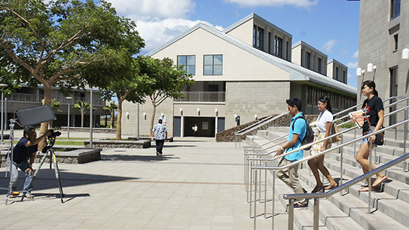
FY16 Highlights
HPC Upgrades & Services
NSF Grants – IRNC-PIREN, CC*DNI, NetSage
Pacific Disaster Center – Five Year Renewal
MHPCC – Still Hanging On
IT Workforce Development
ITC – LEED Gold (It’s Official! … Finally!)
EPSCoR – ‘Ike Wai, Five Year Award

Slide 5
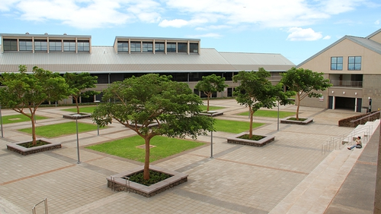
FY16 Highlights
Work-In-Progress
KFS Upgrade to Version 6.0.1
KSCM Implementation – SaaS
PeopleSoft Upgrade to Version 9.1
SAS Analytics & Reporting
Security, Security, Security …

Slide 6
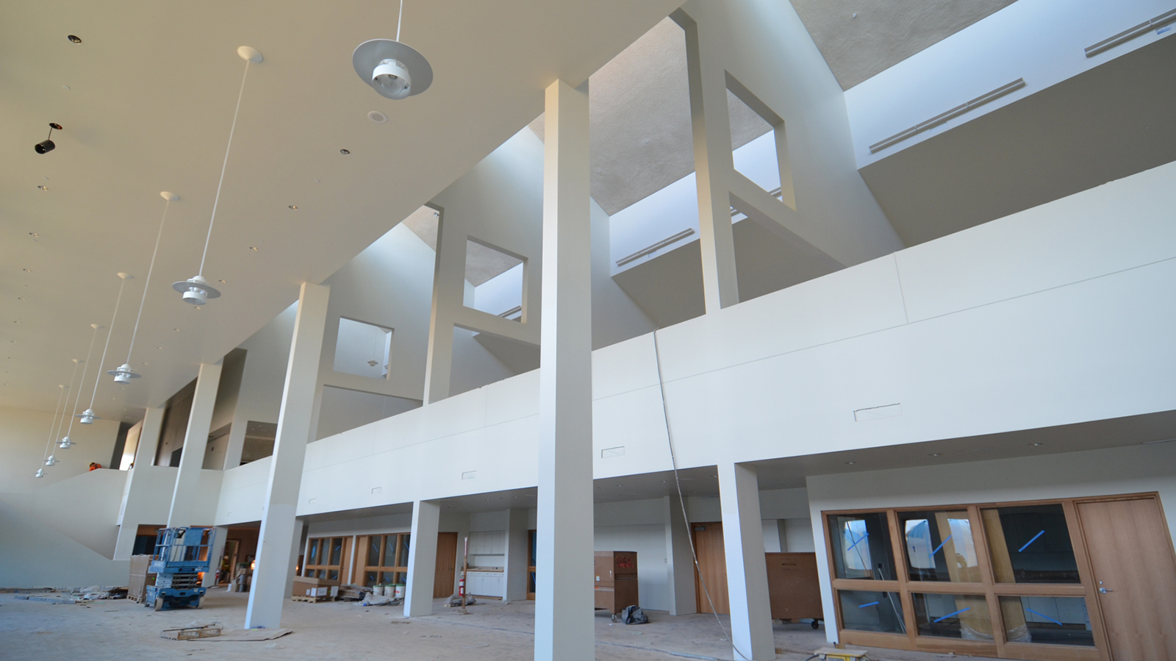
FY17 – Preview
Kuali Core (fka Rice) – Workflow, Formbot
Security – including Multi-Factor Authentication
Infrastructure – Multiple 100G, Servers & Storage, HPC
Client Service and Operations Center (CSOC)
More Banner-STAR Integration
Accessibility – Interim Web Site Accessibility Policy
Research Partnerships
Learning Management System (LMS) Assessment
State App Hackathon

